Slide 1
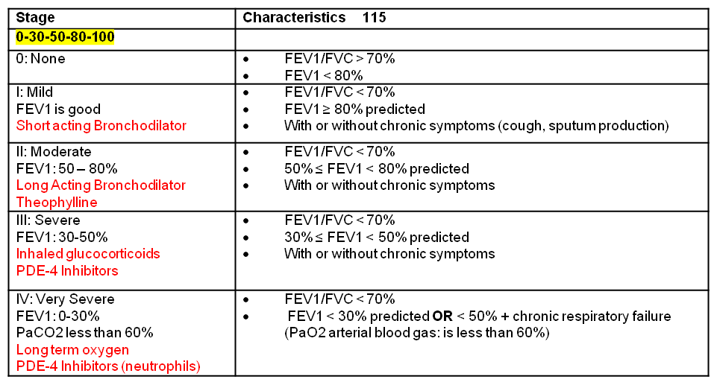
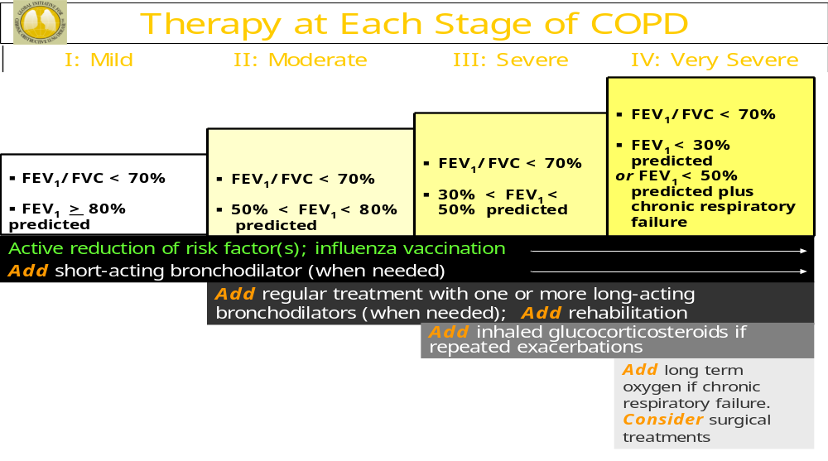
COPD
Chronic Bronchitis: Inflammation of bronchioles. Involved long term mucus
Emphysema: Destruction of alveoli. Destruction of lungs over time

Slide 2
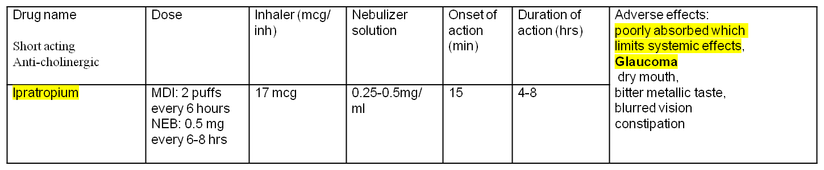
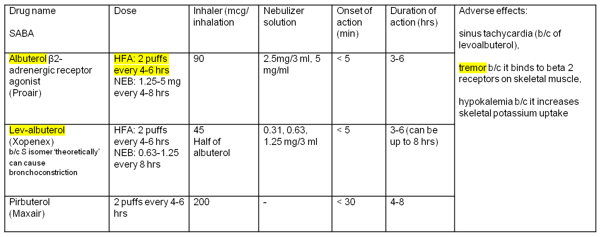
Mild COPD Treatment
Short acting Bronchodilator

Slide 3
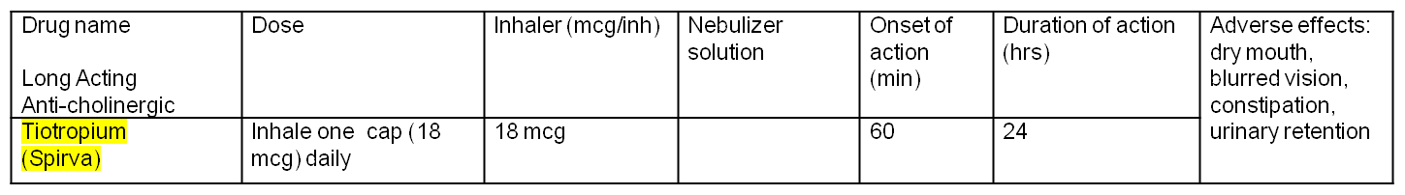
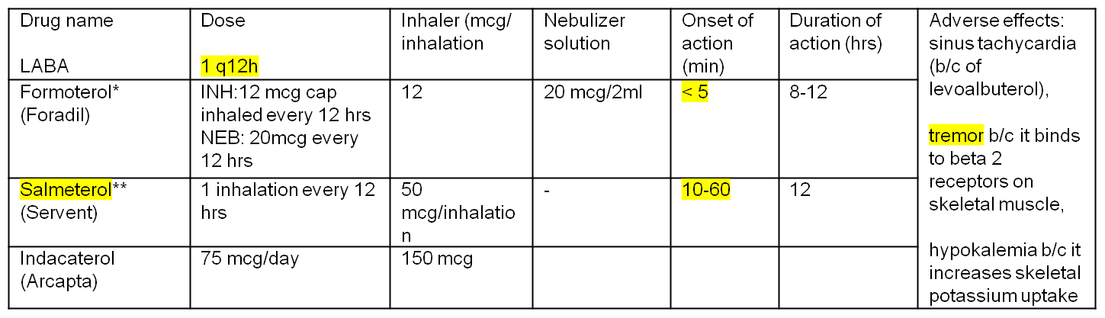
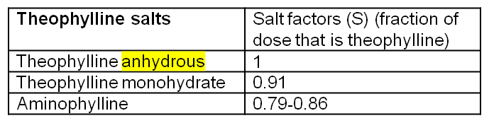
Moderate COPD Treatment
Long acting Bronchodilator (beta and Anti-Cholinergic)
Methylxanthine (Theophylline)
Drug Name Nonselective Phosphodiesterase Inhibitor (PDE)
Theophylline | Usual dose
Therapeutic range 5-10 mcg/ml in COPD | 400-600 mg in divided daily doses
Dose-related toxicities: tachyarrhythmias, seizures, nausea, vomiting, tremors
Adverse effects at usual doses: insomnia, gastric upset, heartburn

Slide 4
Severe COPD Treatment
PDE-4 Inhibitor
Glucocorticoids
Drug name PDE-4 Inhibitors (on neutrophils) | Dose |  | Onset of action (min) | Duration of action (hrs) | Adverse effects: Nausea, reduced appetite (possible weight loss), diarrhea, abdominal pain, insomnia, anxiety depression | Drug interactions with:
Roflumilast (Daliresp) | 500 mcg tablet daily |  | 60 | 24 |  | Inhibitors or inducers of CYP 3A4 & 1A2
Drug Glucocorticoids | Dose | Inhaler (mcg/inhalation) | Nebulizer | Adverse effects
Beclomethasone | 120-240 mcg inhaled every 12 hrs | 40, 80 | - | Hoarseness, dry mouth , oral candidiasis, cough, pneumonia
Budesonide* | INH:360-720 inhaled every 12 hrs NEB: 0.5-1 mg every 12 hrs | 90, 180 | 0.25, 0.5, 1 mg/ 2ml
Fluticasone** | MDI: 132-220 mcg inhaled every 12 hrs DPI: 250-500 mcg every 12 hrs | (MDI)44, 110, 220 (DPI) 50, 100, 250

